Slide 1
DENGAI: PREDICTING DISEASE SPREAD
CS4622 - Machine Learning
Group 06

Slide 2
Team Members
GitHub Link
140062D – G.P.P.D. Bandara
140066T – K.P.T.K. Bandara
140506U – R.A.T.K. Ranatunga
140640A – B.K.D.V. Vimarshana
https://github.com/vibs94/ML_Project_DengAI

Slide 3
Introduction
Research is based on relationship between weather and vegetation in San Juan and Iquitos, and total dengue cases reported in those areas.
The relationship and interaction between diseases and climatic changes are very complicated. So, modeling of such relationships and interactions has been identified as a difficult problem in many research studies.

Slide 4
Introduction
More researches show that depending on the weather conditions and climate changes, dengue transmission patterns varied between years.
The focus of this research study was to explore the different climatic variables and recognize short and long-term predictors and build a model for prediction by ensembling the results from regression methods

Slide 5
Methodology
Two methods used for dengue prediction; regression method and time series method
For regression method, two training models were created for the regression method by changing the window size for smoothing, feature selection and method of imputation of missing values.

Slide 6
Methodology - Regression Model 1
Regression model 1 is created for the Random forest, Extra trees, and Multilayer Perceptron, and got results separately.
Final results were calculated by ensembling results

Slide 7
Methodology - Regression Model 2
Regression model 2 is created for Linear Regression, Random Forest, Gradient Boost, KNN, SVM and MLP with the different preprocessing compared to the first method.
After cross-validation for all six models, the error propagation of Linear Regression, KNN, SVM and MLP is considerably high.
Output values of Random Forest and Gradient Boost ensembled.

Slide 8
Methodology - Regression Model
Final regression model was created by ensembling the results of two regression models
Regression Model 1
Regression Model 2
Ensemble Model

Slide 9
Methodology - Time Series Model
Monthly Trend was predicted by giving month of the record and total number of cases recorded.
Residual values for each week was calculated by deducting monthly trend from actual value.
Residual values and trend was predicted separately by two separate models and predicted values of those two models were added to get the final predicted total cases.

Slide 10
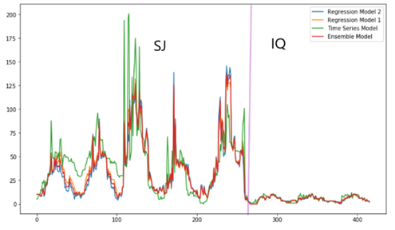
Results
Following image indicates the predicted values of all four models.

Slide 11
Results
Following is the accuracies obtained from four model
Model | Tested Accuracy (MAE)
Regression Model 1 | 21.2188
Regression Model 2 | 21.0168
Time Series Model | 24.8486
Ensemble Model | 19.4856

Slide 12
Analysis
Regression model 1 and regression model 2 have achieved superior performance of 21.2188 and 21.0168 MAE respectively and Ensemble Model got 19.4856
Regression model 1 and Regression model 2 the data preprocessing has done in different methods.
If there is some negative impact because of these operations that were neutralized by ensembling these two models.

Slide 13
Analysis
It can be observed that time series analysis gives better results when there is a dengue outbreak.
Overall Regression Model has abled to provide better results than Time Series Model.

Slide 14
Conclusion
Regression method and time series method used for generating the dengue prediction model.
Two regression models were created changing the methods of the imputation of missing values, smoothing window size and feature selection.

Slide 15
Conclusion
Accuracy of these two models is low when considered separately. But accuracy will increase more when constructing a new model by ensembling the two models.
Reason for this is, error from one model is fixed from the second model.

Slide 16
Conclusion
Another model created using time series analysis.
By comparing the result models from the regression and time series methods, it is found that the accuracy of time series method is considerably low.
Ensembling Regression Model is used to predict the dengue cases on long-term and short-term climate changes and geographical changes.

Slide 17
Thank You!

